Slide 1
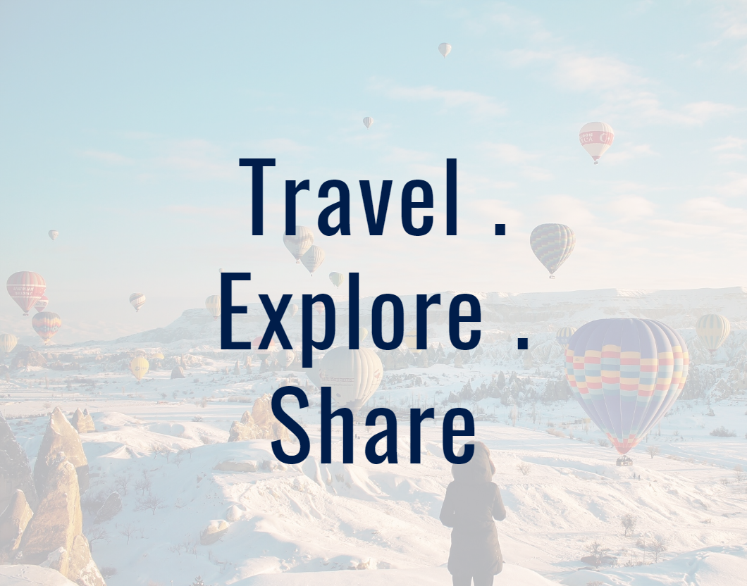
MyEscape a travel blogging website
Ash, Dhanu, Faith, Jomana

Slide 2
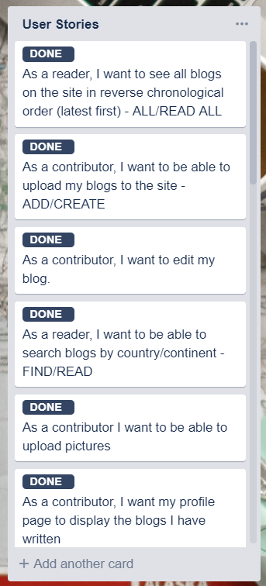
The vision
We chose a travel blogging website as that was something that we could all relate, was interesting and topical, and had a large scope that wouldn’t limit the product.
Began with our user stories – currently 21 of them of which we completed 13 in order of priority (some were quite complex and not viable for the timeframe)
Our initial Minimum Viable Product (MVP) was for our users to be able to read blogs on the website and to be able to add blogs
(Possibly underestimated ourselves)
Our broader vision included:
Increased functionality for users – update blogs, delete blog, add pictures
Control of actions via registering/logging in
Search functionality, organisation of blogs in different ways – by geography, category, number of views, date posted
Being able to share the blog on other platforms
Bookmarking of interesting blogs by users
Admin review of blogs

Slide 3
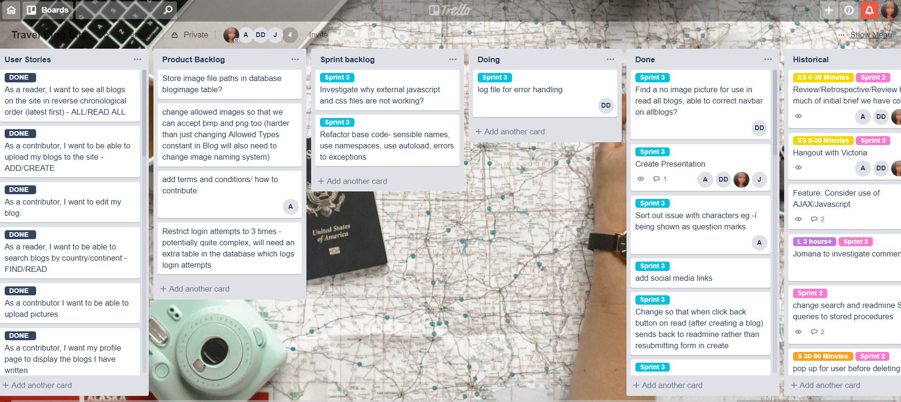
How we organised ourselves
Daily stand-ups
Scrum master with estimation of time
Weekly(ish) sprints
Forward sprints
Reviews and Retrospectives
Almost daily hangouts (not prescriptive, based on need) – used for brainstorming, planning and prioritising, allocating tasks, going through code and initial tasks together, problem solving
Notes:
We did get faster in terms of PHP but slowed down again when came to CSS

Slide 4
Project flow
Database creation
Wireframes
Styling
Adding functionality to match high priority user stories
Initial Planning
Understanding and mapping our MVC model
Responsiveness
Presentation
Get code working
Testing, error handling, coding defensively
Making the product more useful
Sprint 1
Sprint 2
Sprint 3
Notes:
Diagram shows the priorities in each sprint
Revolving arrow indicates that it was an Agile process, all elements continuously reviewed and tweaked as necessary for the product – e.g. making database refinements in week 3

Slide 5
What went well
How quickly we grasped MVC
Organisation and prioritisation – smooth flow of project
Commitment to Trello – tracking what’s being done, by who, when
Functional product
Underestimated ourselves, put together something more substantial than our MVP
Team worked well together
Workload evenly distributed
Everybody flexible, understanding, listened and helpful
Stress was managed
Pragmatic approach – got on with it
Everyone was reliable
Limited hangout time, more action less talking

Slide 6
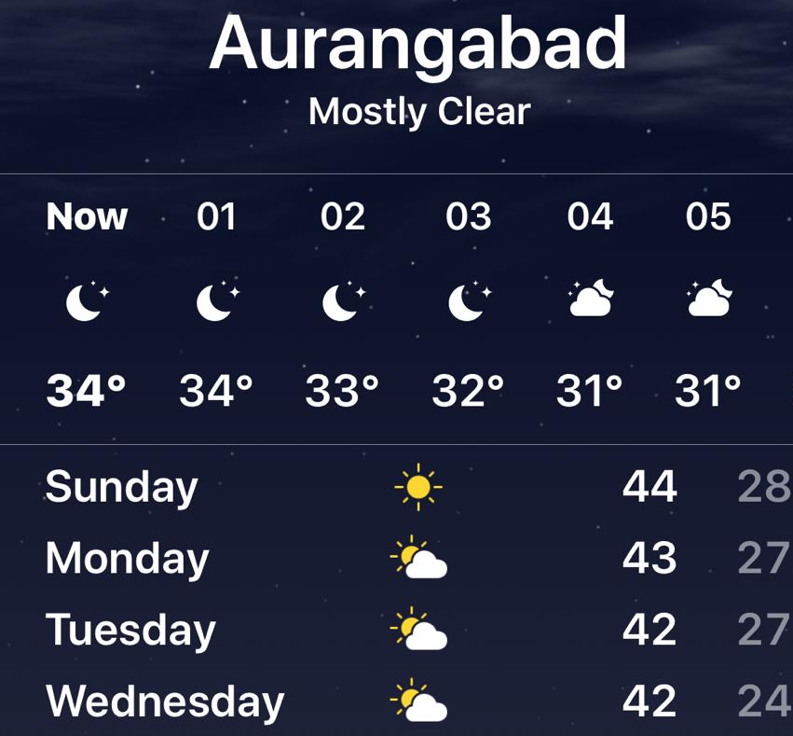
Challenges
Personal
Balancing life/family/commitments as well
One team member working from India (due to family situation) – heat and different time zone
Periods of illness for various team members
Technical
One team member had a corrupted PHP MyAdmin – couldn’t access our database for a few days until resolved
One team member could never hear people on hangouts ☺
Took some time (and reversed commits) to get the hang of GitHub – using branches, managing conflicts, Terminal vs Desktop
Conflict between different bootstrap versions used when styling
Skills
Learning on the job – trying and testing as we went
We were slower with CSS/HTML/Javascript than PHP due to less time practising those skills

Slide 7
Even better if…
Perhaps we could have mapped out styling a bit more before getting stuck in so that we had more consistency across webpages from the start
We assigned styling a bit too early which meant we had to spend time at the end making it all look consistent and handling styling/CSS clashes
Used GitHub in the same way from the beginning (some used Terminal, some Desktop, some Browser)
Notes:
This is with regards to us working up to this point – the next slide covers how we would take the product further

Slide 8
Future steps for our product
Introducing more security
hashing passwords (we tried)
using cookie session IDs to track user
restricting login attempts
password verification via email links
Refactoring code – for efficiency and to reduce redundancy
Functionality – Incorporating our more complex user stories
Capacity to incorporate Twitter and Instagram feeds
Ability to bookmark/save blog posts of interest
An extra layer between posting a blog and it being published whereby an administrator could review the content to make sure that it’s appropriate and legible
Considering accessibility for differently-abled people
Support for other languages

